Slide 1
Setting up Atlas

Slide 2
Step 1: Create Account/Log-in

Slide 3
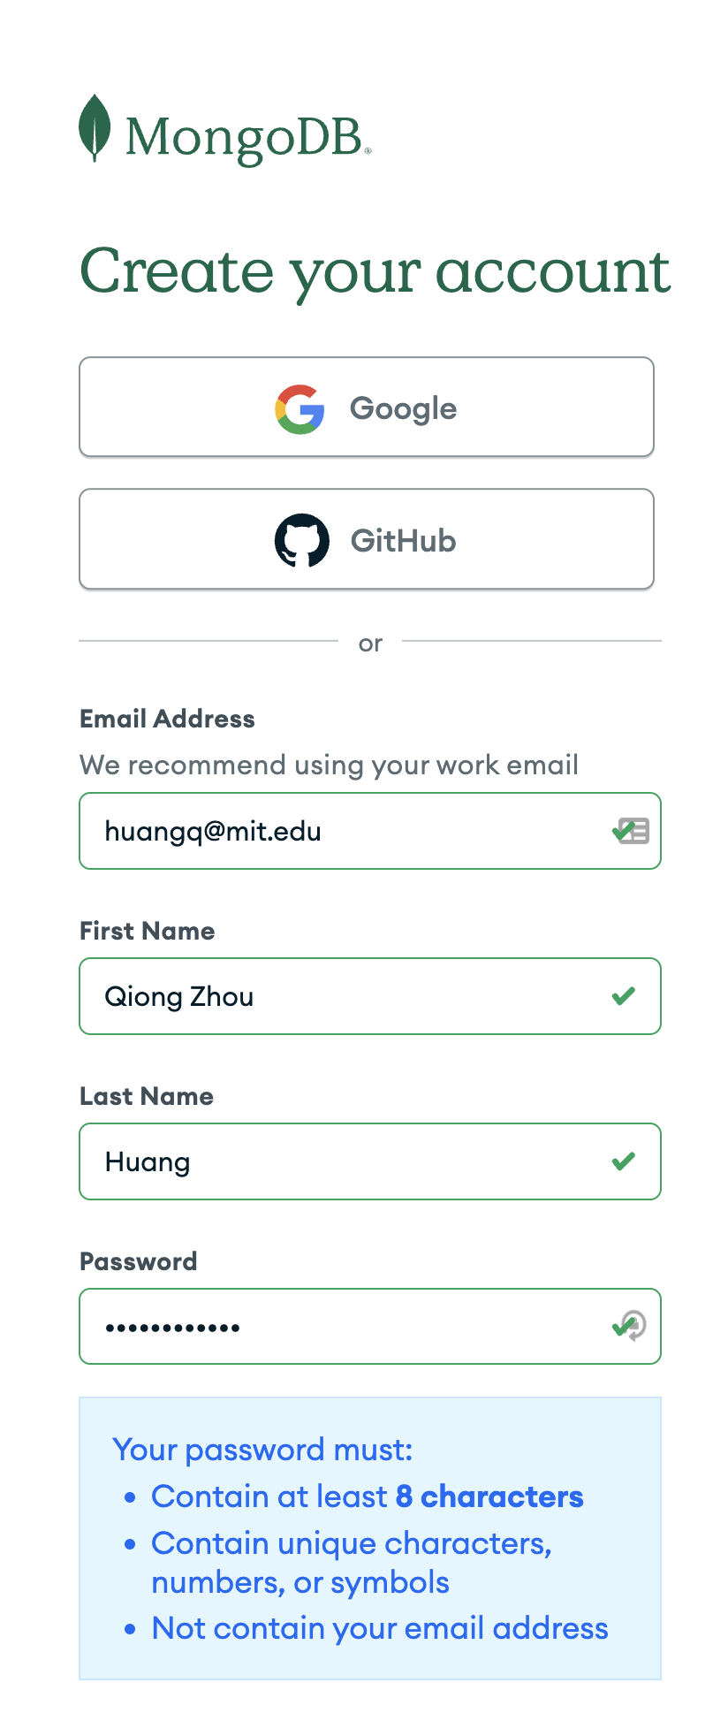
Create an account + log-in
Returning user?
Go to https://account.mongodb.com/account/login
Log-in
Skip to Step 1.5
Need to make an account?
Go to https://account.mongodb.com/account/register
Sign up for an account using any email, Google, or GitHub OAuth
Verifying email should automatically lead you to Step 2.
If you do not automatically see Step 2’s page, follow Step 1.5.

Slide 4
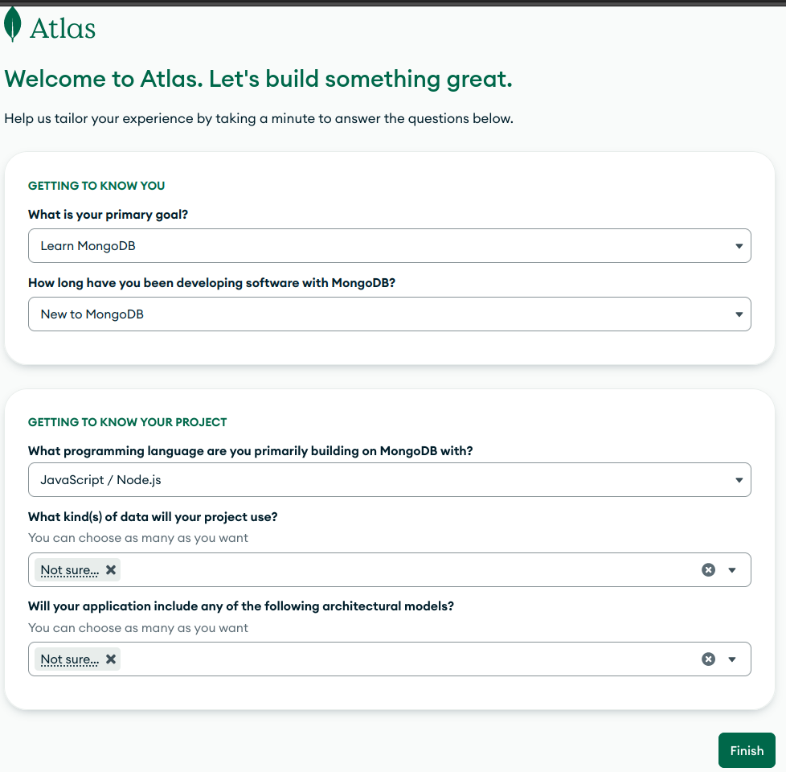
Hit Finish here
Feel free to select what you think most applies to you!
You do not need to know what kind of data or architectural models and can just select “Not Sure” if you don’t know
JavaScript is a good choice as preferred language

Slide 5
Step 1.5: Create an new Project
(If you are a returning user!)

Slide 6
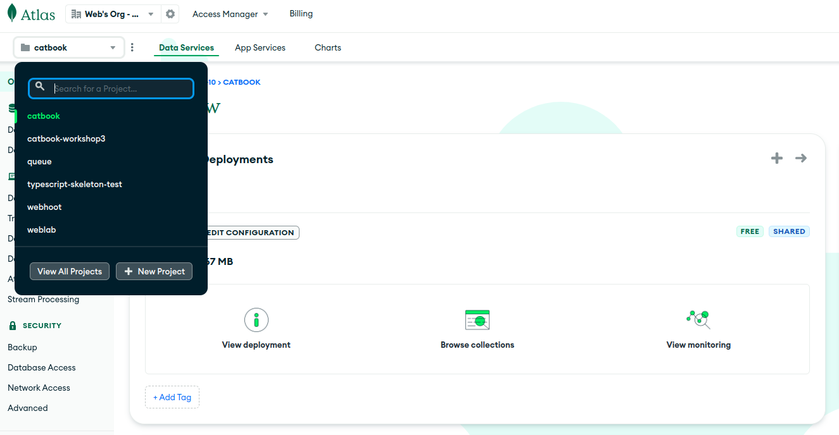
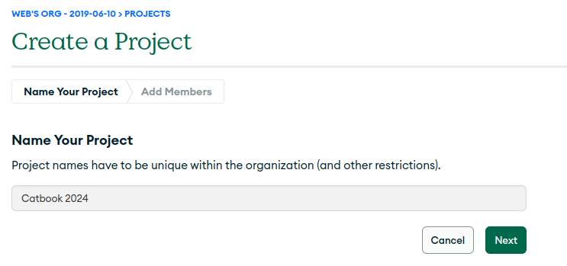
Create a new Project + Name
Create a new project
Name it accordingly
Name it Catbook if it is for the lecture workshops
Name it your project’s name if it is for web.lab project
Share it accordingly
Don’t share with anyone if it is for the workshop
Share it with your team if it is for your web.lab project

Slide 7
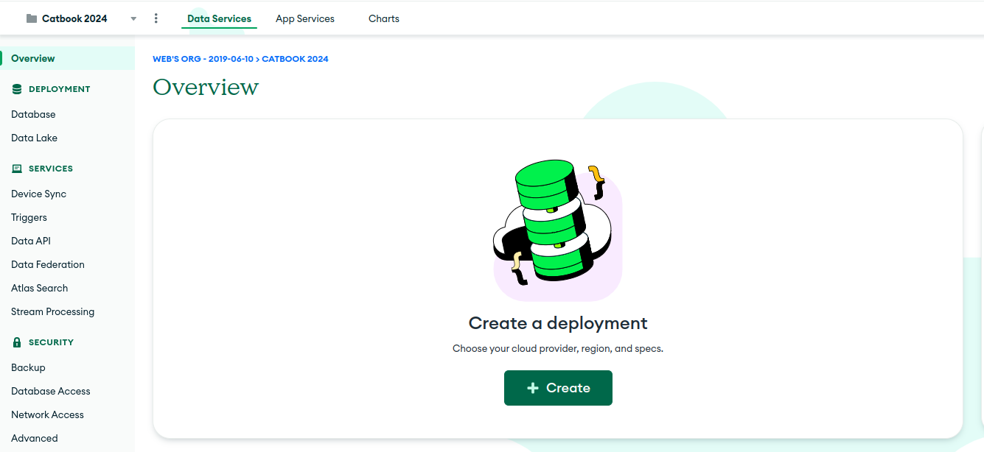
Make sure you are on the correct project
Create a deployment and follow Step 2
Navigate between projects here

Slide 8
Step 2: Create a Free Database

Slide 9
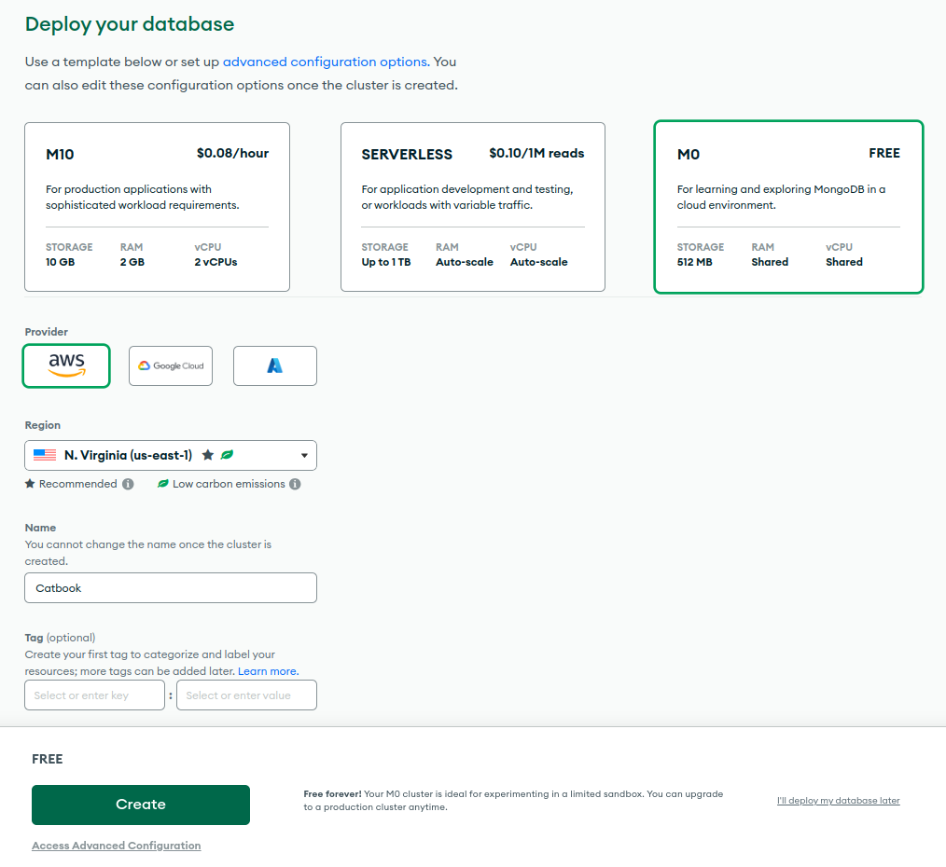
Deploy your database
If you created an account
this page is automatically the next step when creating an account.
Otherwise follow Step 1.5

Slide 10
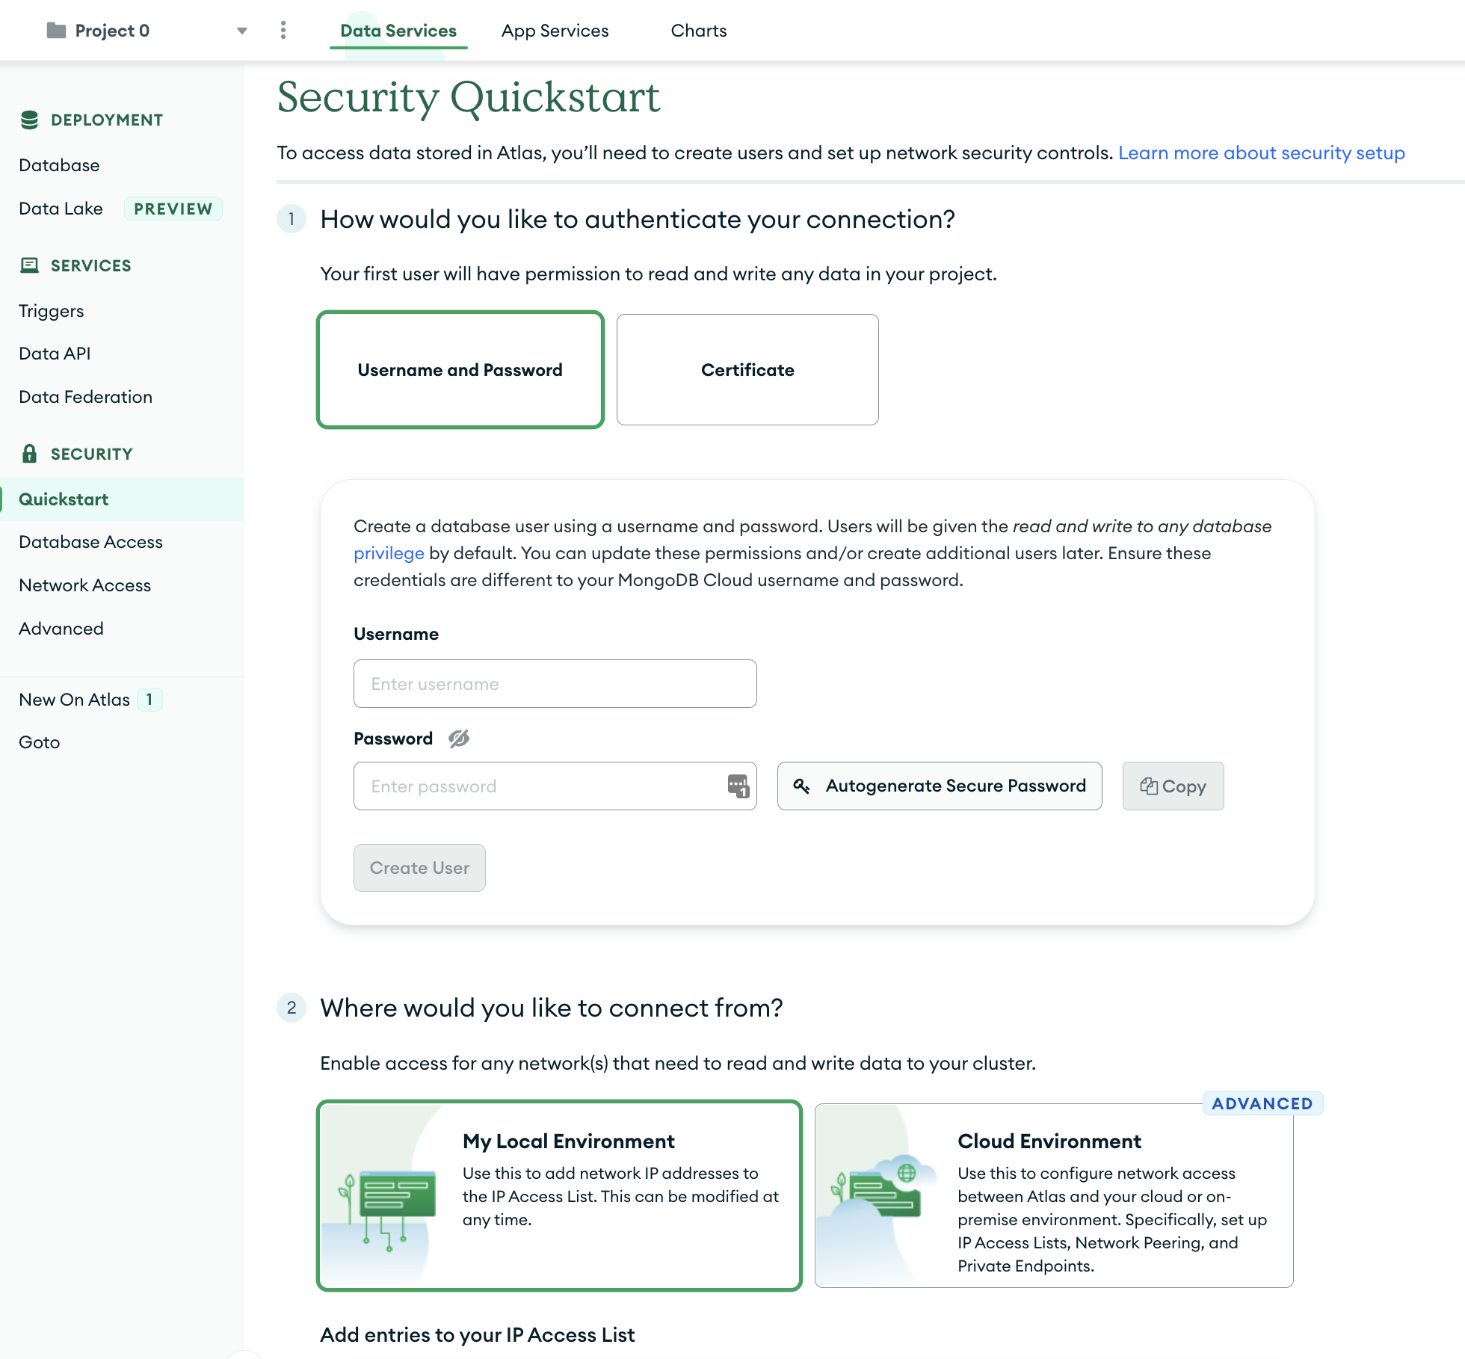
You should reach the Security Quickstart Now

Slide 11
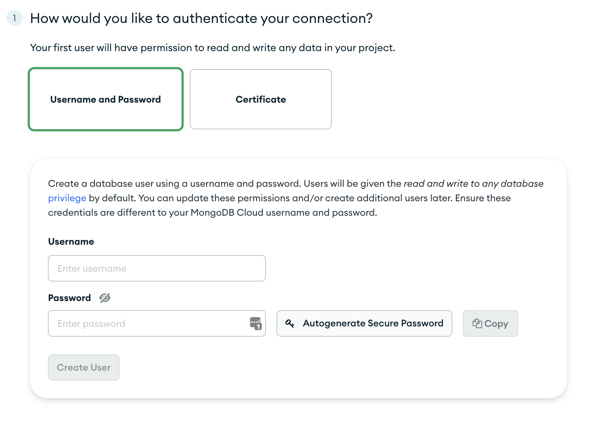
Create a Database User
MAKE SURE YOU REMEMBER YOUR USERNAME AND PASSWORD
don't use a personal password
(we recommend just using the autogenerated secure password)
[okay, this was kind of a scare tactic, you can always regenerate your password]

Slide 12
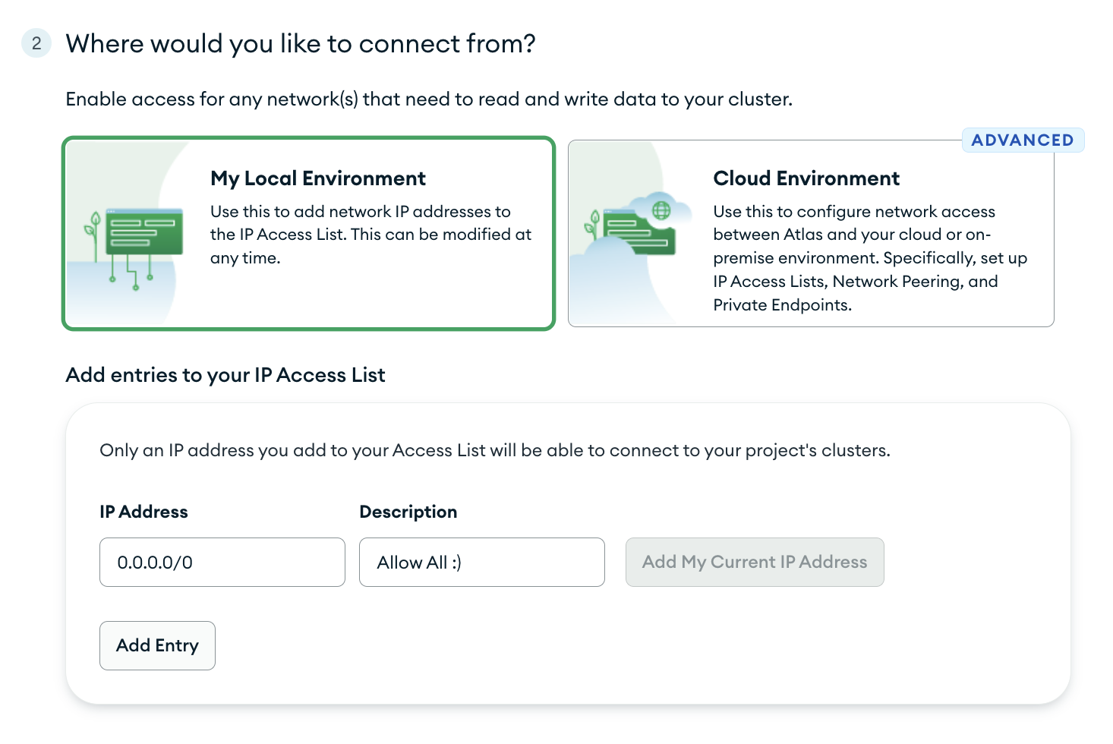
Add your IP address to the access allow-list
Adding 0.0.0.0/0 to the allow-list gives all IP addresses access

Slide 13
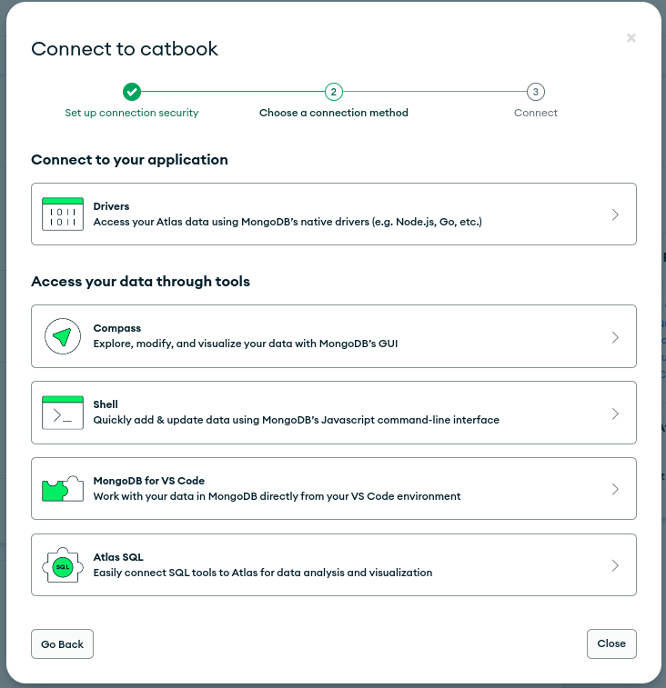
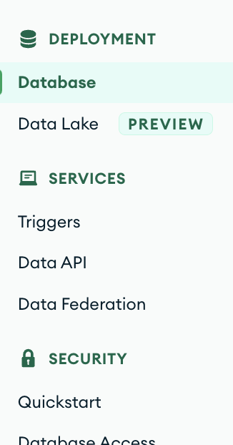

Getting your SRV

Slide 14
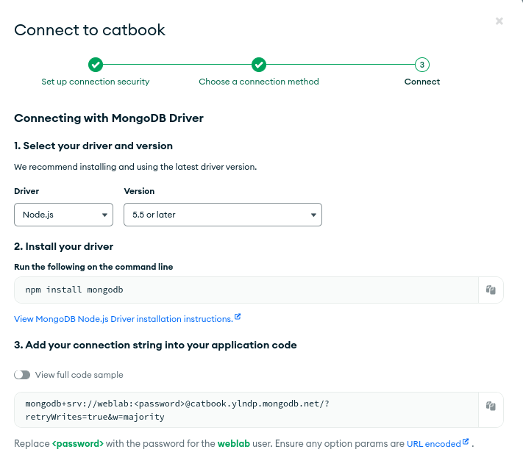
Getting your SRV
Save this string somewhere (or you can copy it later). We’ll need it on Friday.
Make sure you replace the <password> field with the password you created for the user. If your username is not “admin” then you should also verify that the username is correct.
(the final srv should not have the < or the > )

Slide 15
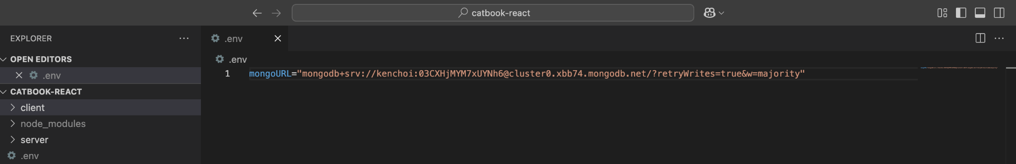
Recommended: add mongoURL to .env
Create a file called .env in your root catbook-react folder, and in that file add one line
mongoURL=<insert mongoURL from Atlas>
This will save you from having to insert the mongoURL on every step!

Slide 16
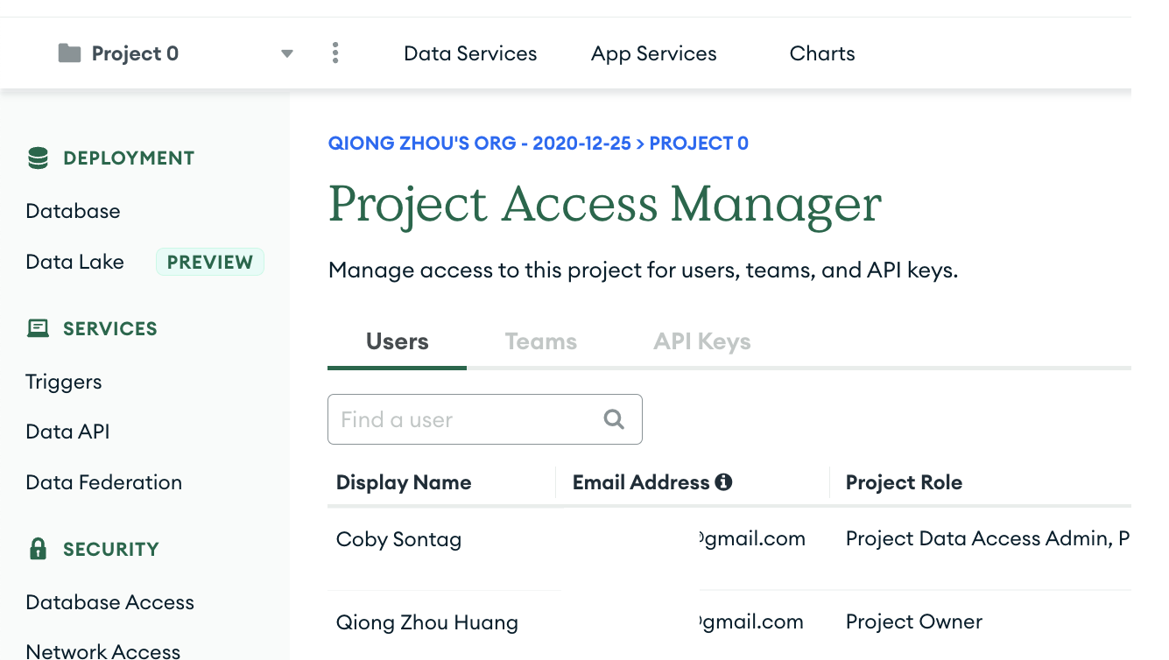
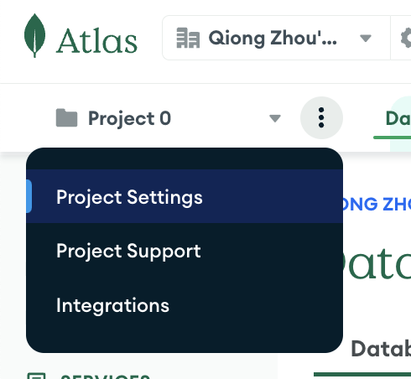
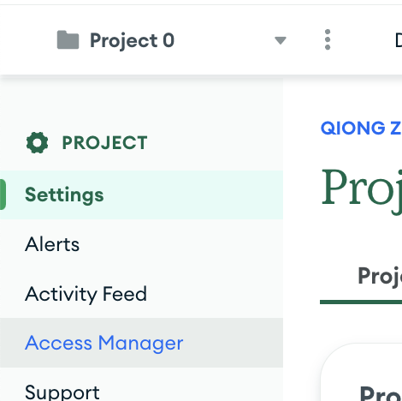
Optional: Sharing access to Mongo Atlas to your teammates

